Slide 1
Weekly report: Electrical Drivetrain
Week number: 9
Date: 11/25/2025
Supervisor: Prof. Dr.-Ing. Saiju
Group members: Aiswarya Vijayan, Vishranti Shivajirao Patil , Girish Mahadeo Padalkar, Cristina Milene Vergara Hernandez

Slide 2
List of contents
Implement MATLAB model of the DFIG
Generate characteristic curves for DFIG
Begin building the Simscape model for all drivetrain components
Cable Calculations
Cristina Vergara
Electrical Drive Train/ Optimus Syria

Slide 3
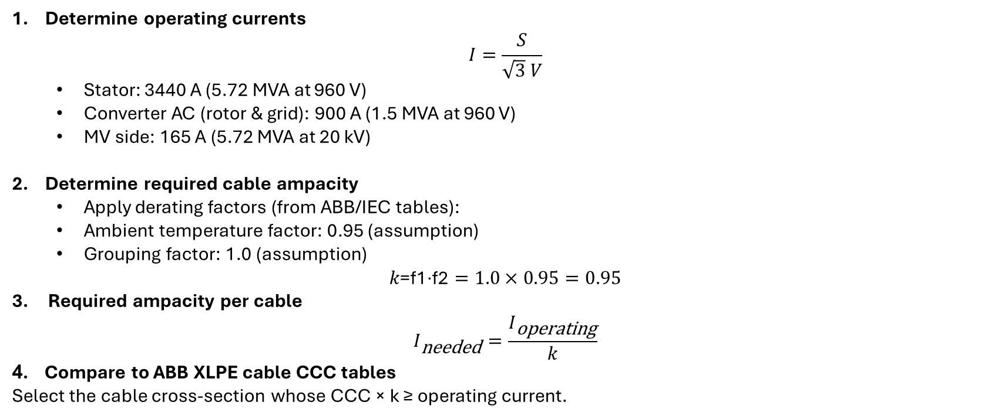
Cable cross-section calculation
Determine operating currents
$I=\frac{S}{\sqrt{3} V}$
  Stator: 3440 A (5.72 MVA at 960 V)
  Converter AC (rotor & grid): 900 A (1.5 MVA at 960 V)
  MV side: 165 A (5.72 MVA at 20 kV)
Determine required cable ampacity
  Apply derating factors (from ABB/IEC tables):
  Ambient temperature factor: 0.95 (assumption)
  Grouping factor: 1.0 (assumption)
$$k\text{=}\text{f}\text{1​}\text{⋅}\text{f}\text{2​}=1.0×0.95=0.95$$
3. Required ampacity per cable
$$I_{\text{needed}}=\frac{I_{\text{operating}}}{k}$$
4. Compare to ABB XLPE cable CCC tables
Select the cable cross-section whose CCC × k ≥ operating current.
Cristina Vergara

Slide 4
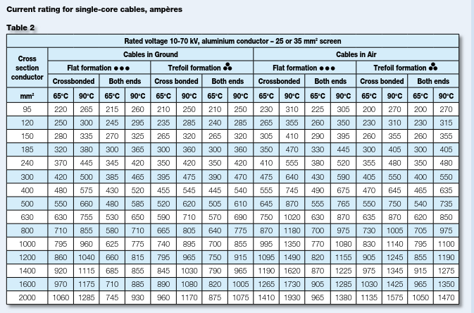
Cable cross-section calculation
Cristina Vergara

Slide 5
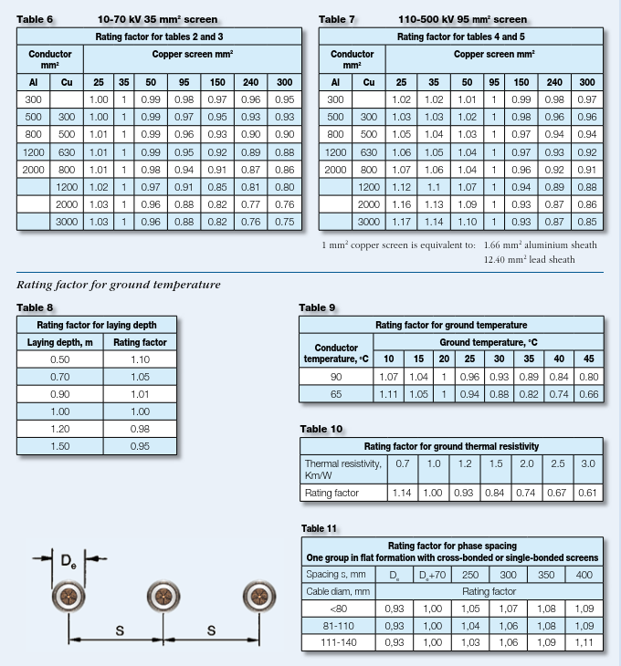
Cable cross-section calculation
Cristina Vergara

Slide 6
Final Cable Selection for the Drivetrain
3. Grid-Side Converter → LV Transformer (900 A)
  Same current as rotor-side converter
  Same cable type chosen for symmetry
  → 1 × (1×630 mm² Al) per phase
4. MV Transformer → 20 kV Switchgear (165 A)
  ABB NA2XS2Y 1×95 mm² Al (12/20 kV): CCC ≈ 260 A → derated ≈ 196 A
  Required current: 165 A < 196 A
  → 1 × (1×95 mm² Al, 12/20 kV)
1. Stator → LV Transformer (960 V, 3.44 kA)
Required CCC per phase after derating: ≈ 1480 A
ABB 630 mm² Al LV cable: CCC ≈ 780 A → derated ≈ 589 A
Practical OEM solution (short nacelle run):
3 × (1×630 mm² Al) per phase
→ Total: 9 single-core LV XLPE cables
2. Rotor Windings → Rotor-Side Converter (900 A)
  Required CCC after derating: ≈ 1190 A
  One 630 mm² Al cable is acceptable for short runs (converter inside nacelle)
  → 1 × (1×630 mm² Al) per phase
Cristina Vergara

Slide 7
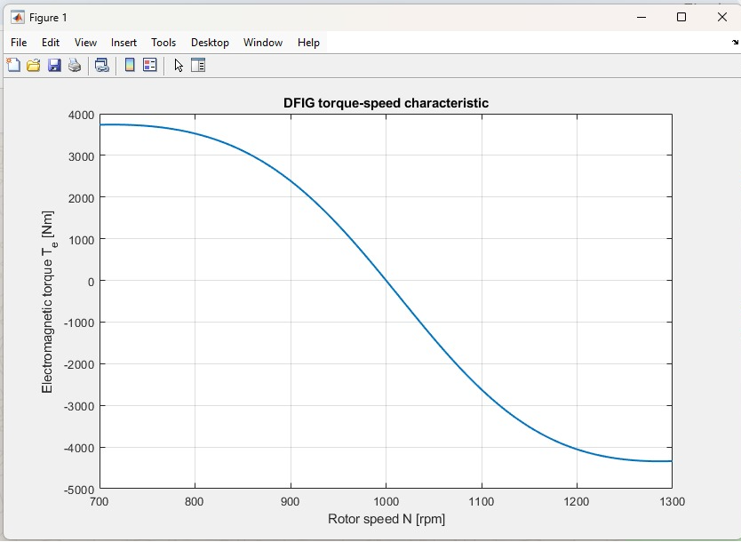
Torque-Speed Characteristic
Torque is positive below synchronous speed
Zero torque ~1000 rpm
Negative torque above synchronous speed → generator region
Curve shape matches theoretical DFIG characteristics
Cristina Vergara

Slide 8
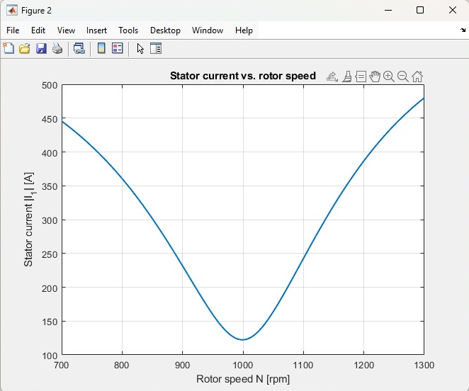
Stator Current vs Rotor Speed
Stator current is lowest near synchronous speed
Higher slip → higher stator current
Symmetrical behaviour indicates correct model implementation
Cristina Vergara

Slide 9
Mechanical Power vs Rotor Speed
Mechanical power peaks at low speed (motor side)
Zero crossing at synchronous speed
Becomes negative in generator range (expected)
Confirms correct energy flow direction
Cristina Vergara

Slide 10
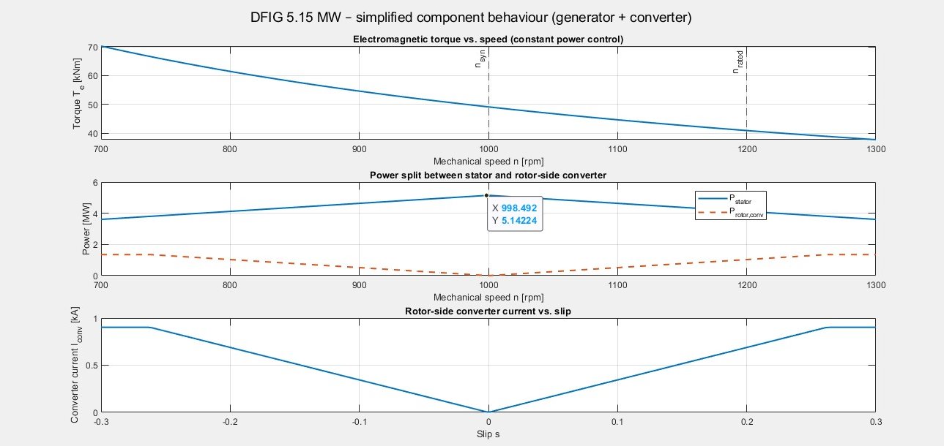
Mechanical Power vs Rotor Speed
Torque vs. Speed: Constant-power control → torque decreases as speed increases.
Power Split: Stator delivers most power; converter only handles slip power (~20–25%).
Converter Current: Increases with slip; reaches rated limit near ±0.3 slip.
Overall: Confirms correct DFIG behaviour—small converter handles variable-speed control while stator feeds main power to grid.
Cristina Vergara

Slide 11
6.Next Step
Complete the Simscape drivetrain diagram and add all parameters.
3D modeling (Fusion 360) of components
Cristina Vergara

Slide 12

Bibliography
MathWorks. Simscape Electrical Documentation.
https://www.mathworks.com/help/sps/
Access Date – 06/11/2025
MathWorks. Asynchronous Machine (Wound Rotor) – Simscape Electrical.
https://www.mathworks.com/help/sps/ref/asynchronousmachine.html
Access Date – 06/11/2025
MathWorks. DFIG Wind Turbine Examples (Simscape).
https://www.mathworks.com/help/sps/ug/wind-turbine-modeling.html
Access Date – 06/11/2025
MathWorks. Wind Turbine Induction Generator Models.
https://www.mathworks.com/help/sps/powersys/ref/dfigwindturbine.html
Access Date – 06/11/2025
XLPE%20Cable%20Systems%20Users%20Guide (003)
11/25/2025
Cristina Vergara
9

